Slide 1
ClimbXpert
Find your holds, easy
Team: Nir Ozery, Alon Strutsovsky, Itai Lahat

Slide 2
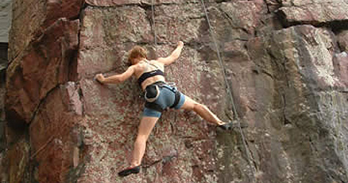
The Climbing World
Climbers are looking for official climbing routes
On site, it is sometimes hard to find the climbing routes and harder to classify their difficulty level

Slide 3
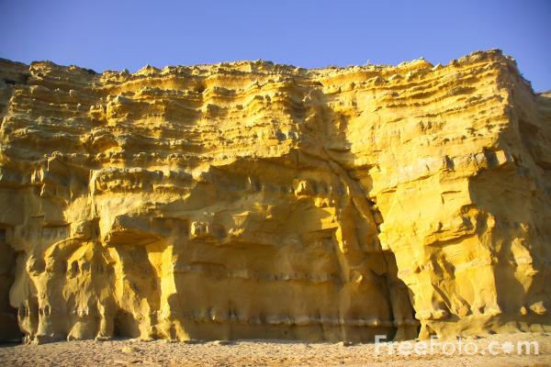

Find Routes on Site
6c
6a
5b

Slide 4
Main Features
Provide a data base of rock climbing routes
Show the climbing sites on a map
Show the routes and their steps on site using the camera

Slide 5
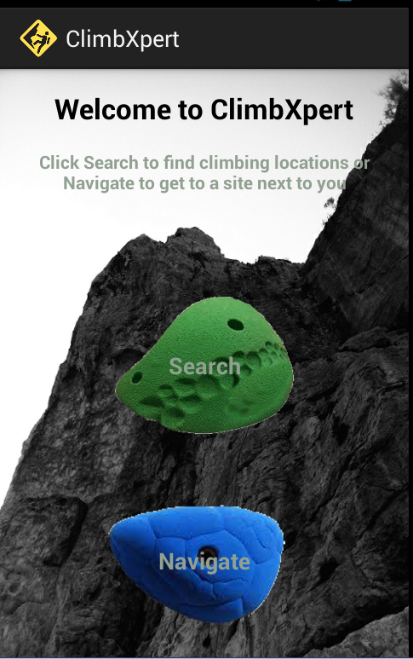
The Application

Slide 6
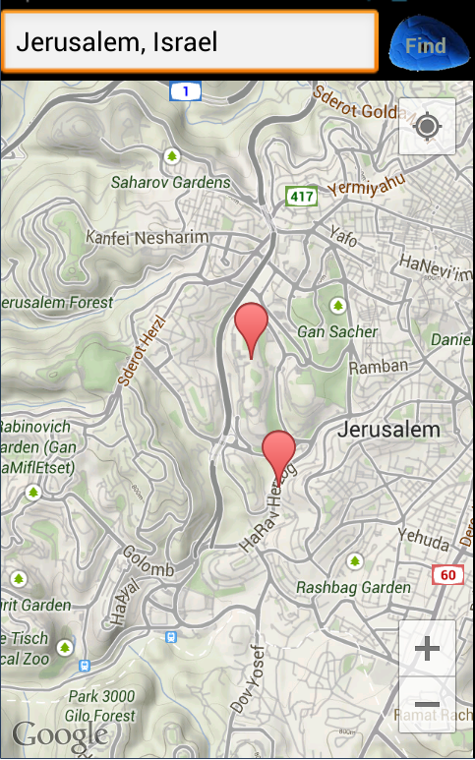
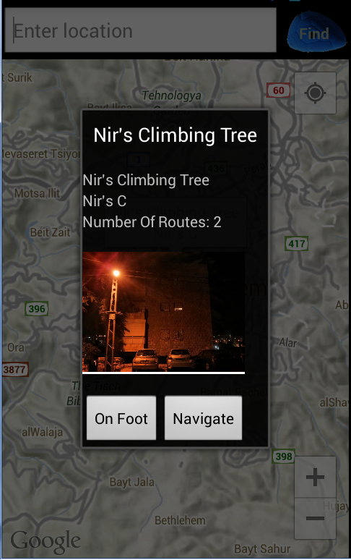
Search Activity

Slide 7
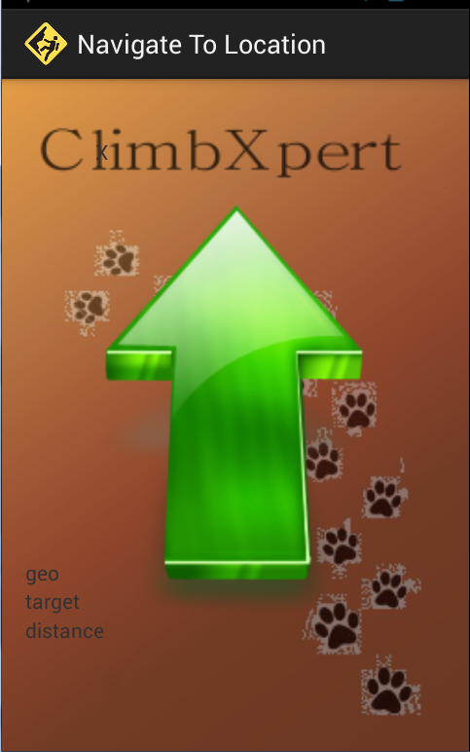
On Foot Navigation

Slide 8
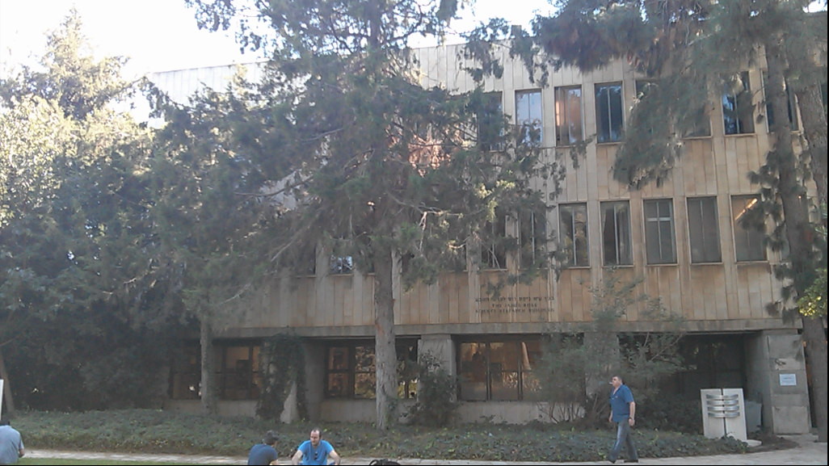
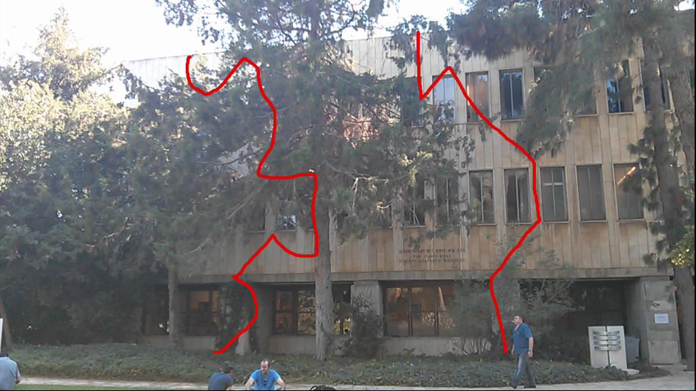
AR – On screen information

Slide 9
Sensors
y
Tilt
Magnetic, Gravity, GPS
Smoothening (using buffers)
Extracting and Crossing relevant data
z
Azimuth
Rotation
x

Slide 10
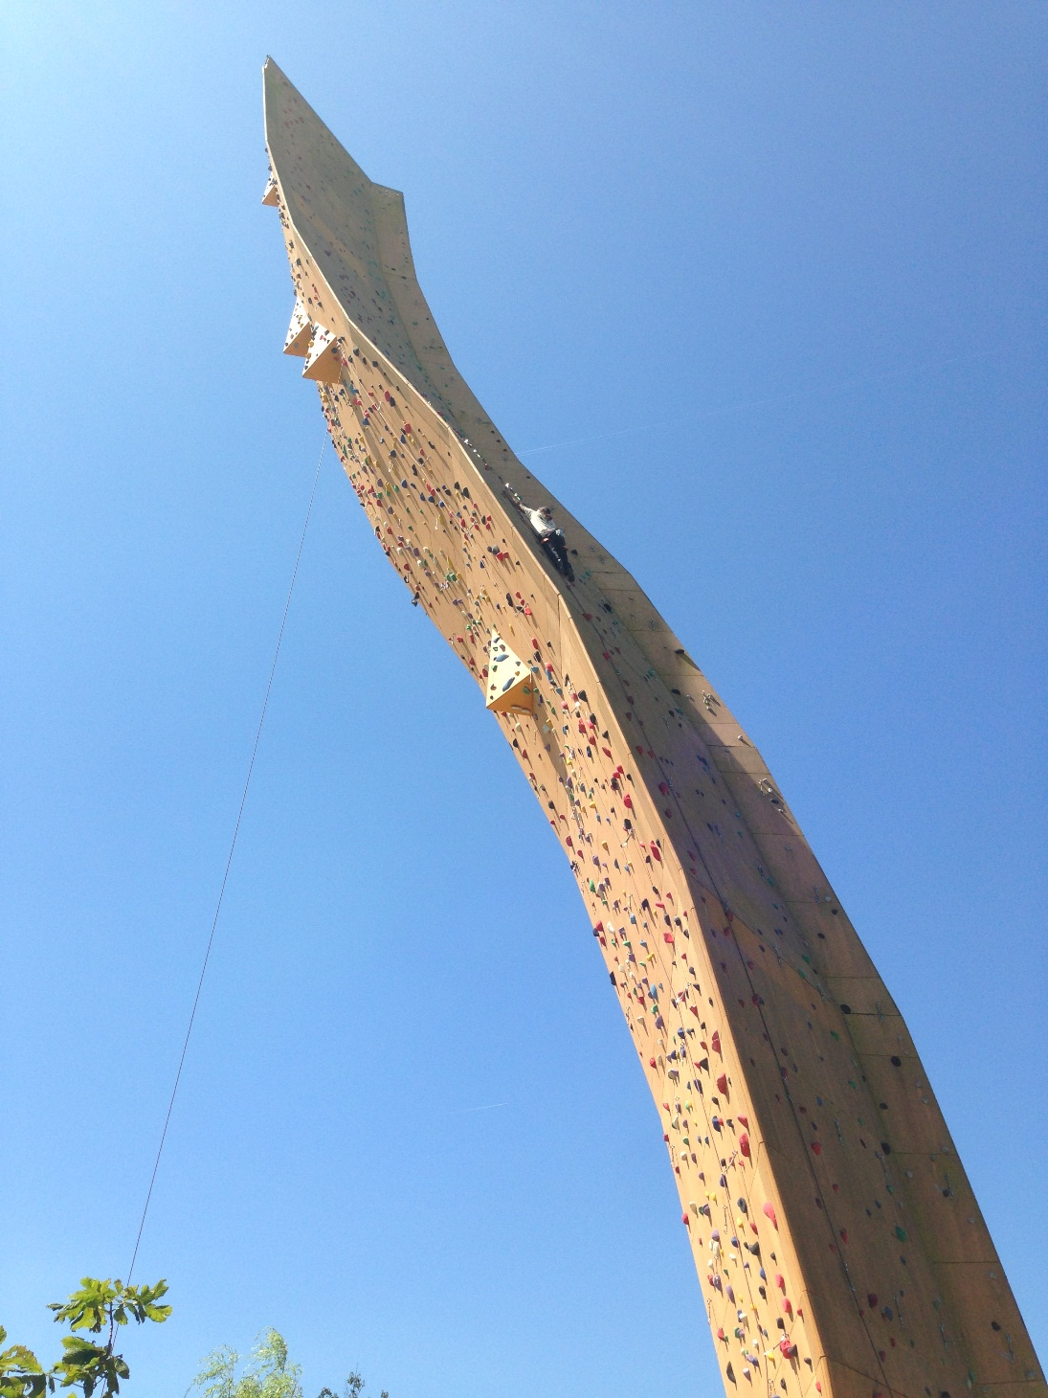
Just Climb!

